Slide 1

A Semantic Annotation System for Web of Things
Du Sicong
BUPT number : 2013213144
QM number : 130801256
Project No. : RC_3144
Notes:
注意： 想要 在此幻灯片上使用不同的 图像？请选择 该图片并将其删除。 现在， 在占位符中单击“图片”图标以便插入自己的图像。

Slide 2
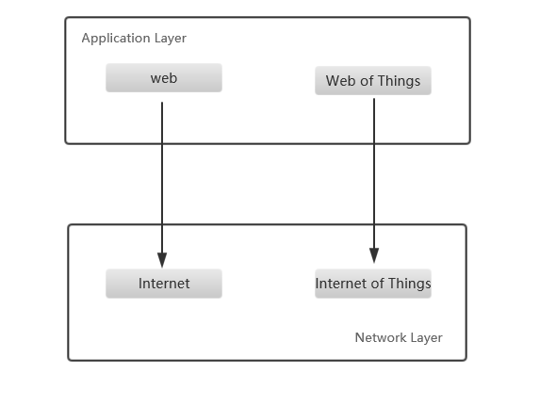
Web of Things
Reuse web pattern and protocols
Simplify the application creation
Make things part of WWW

Slide 3
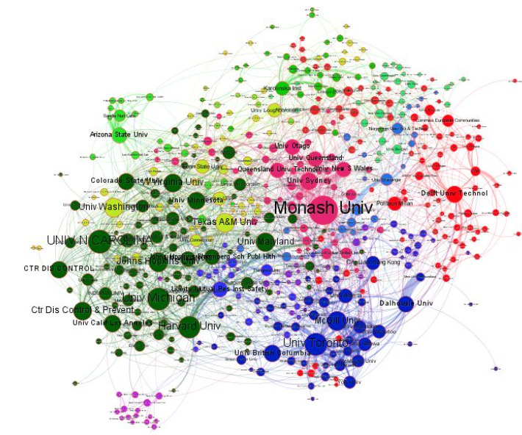
Semantic annotation
Metadata
Construct a knowledge graph
Machine understandable
Search , reasoning .

Slide 4
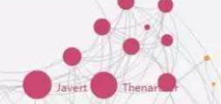
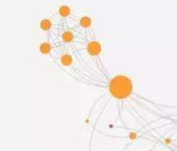
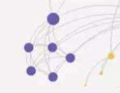
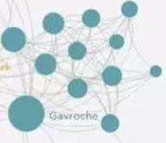
Present status
Domain specific knowledge base
Isolation among WoT application

Slide 5
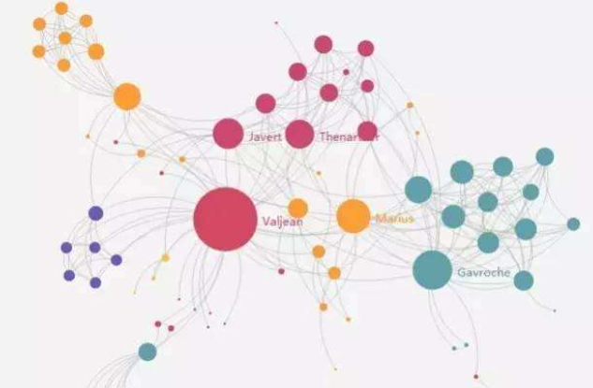
Motivation
Connect them together
Growing body
Ambiguity : different definition but the same meaning
Take a global domain independent knowledge base as medium

Slide 6

Semantic annotation system
Manual
Automatic
generate
Networked knowledge infrastructure

Slide 7
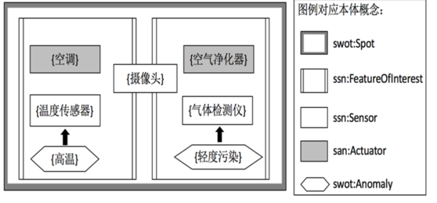
Manual annotation tool
Ontology design
Legend for ontology:
Air conditioner
Air cleaner
Camera
Thermometer
Gas detector
High temperature
Light pollution

Slide 8

Manual annotation tool
Proof-of-concept Implementation
Jena-TDB
Mysql
Web Front end

Slide 9
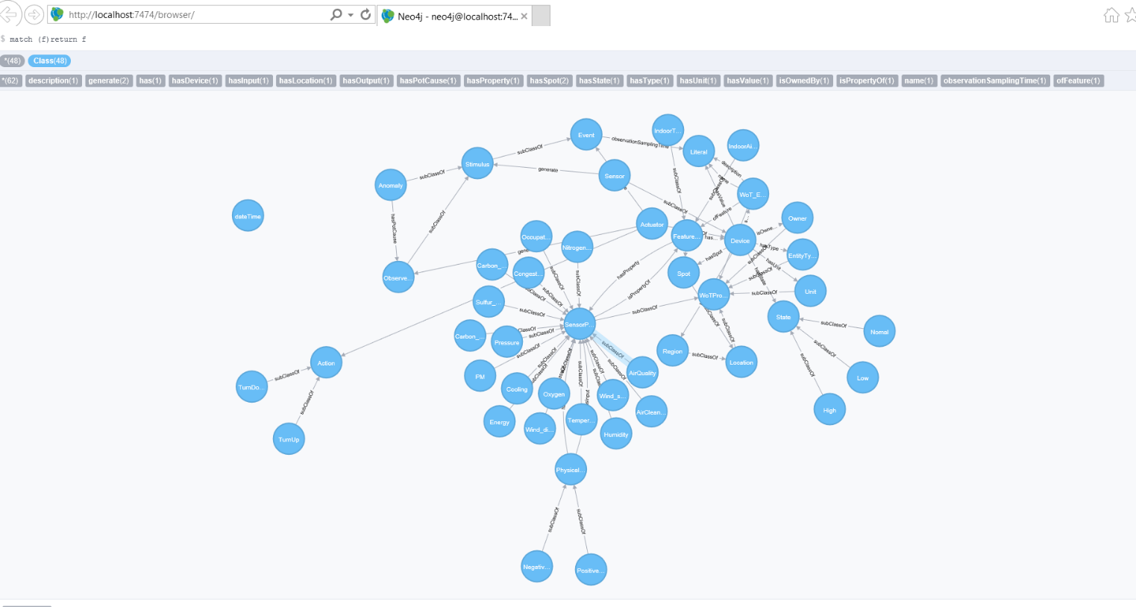
Manual annotation tool
Initial local knowledge base

Slide 10
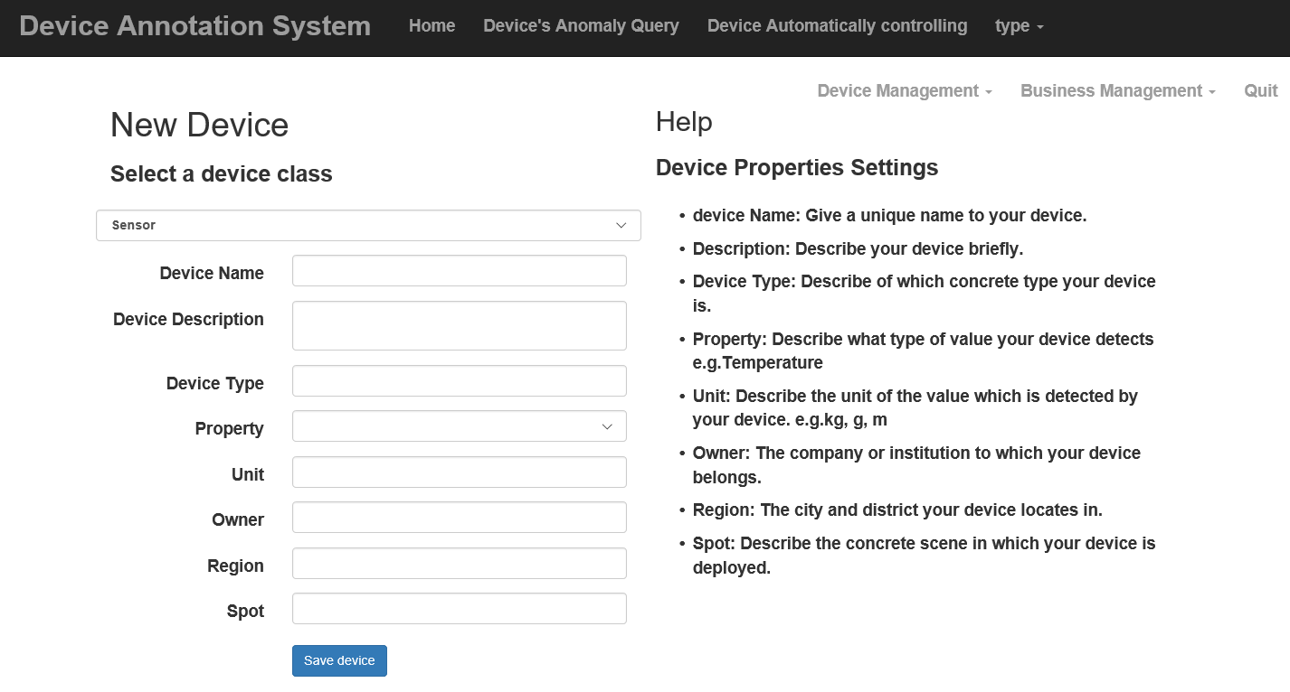
Manual annotation tool
Input UI

Slide 11
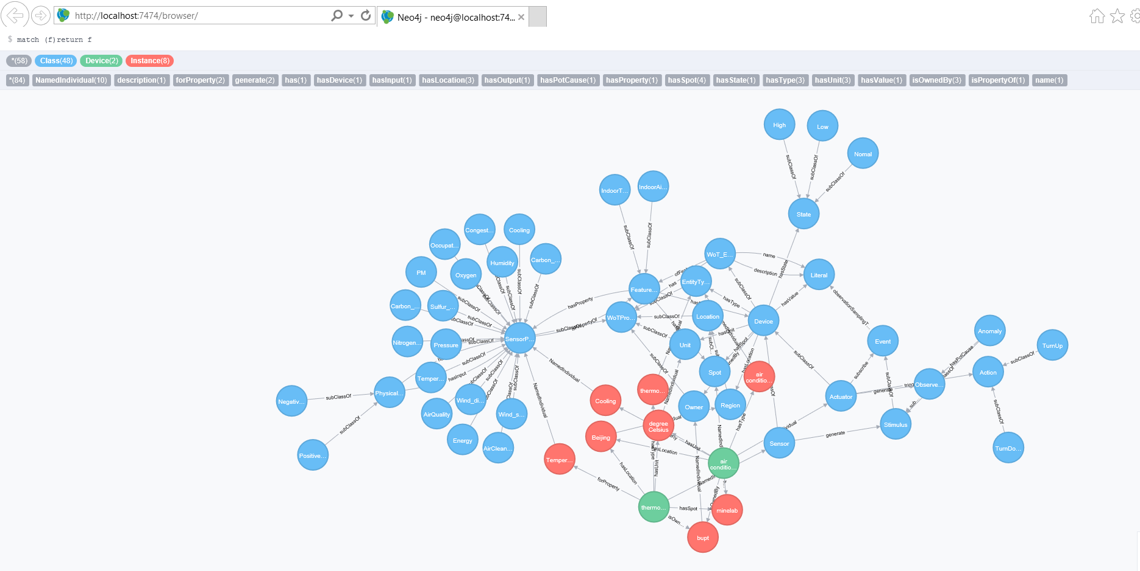
Manual annotation tool
Local knowledge base after manual annotation

Slide 12
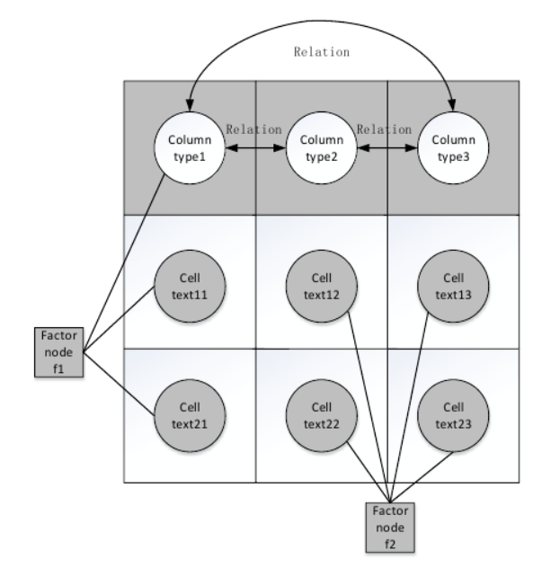
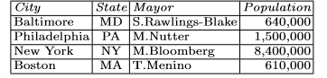
Automatic annotation tool
Factor graph model

Slide 13
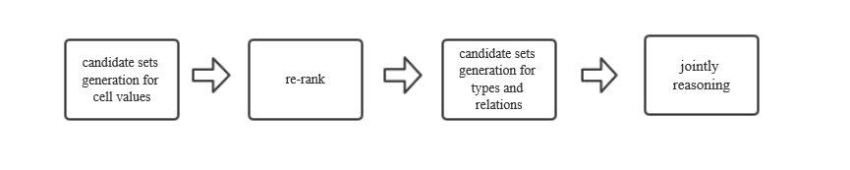
Automatic annotation tool
• Message passing
Iterative
Entity linking

Slide 14

Automatic annotation tool
Proof-of-concept Implementation
EL
module
Jena-TDB
Mysql

Slide 15
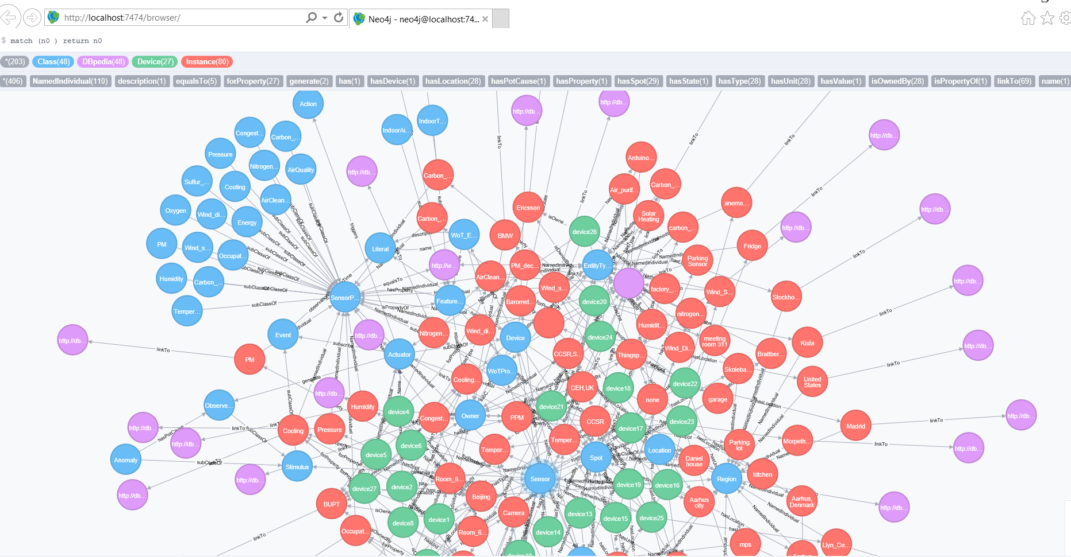
Automatic annotation tool
Local knowledge base after automatic annotation

Slide 16
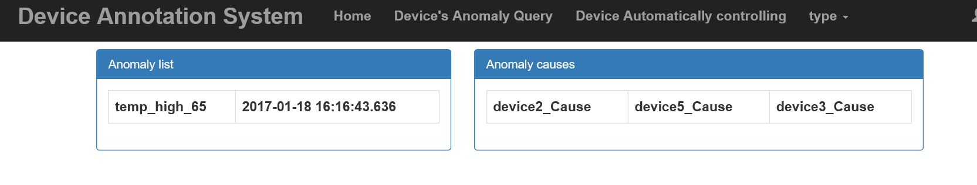
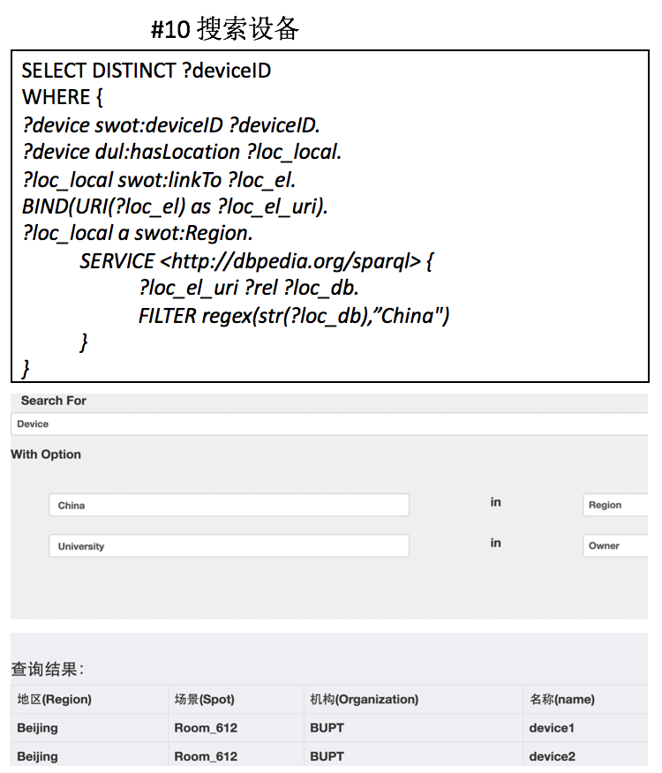
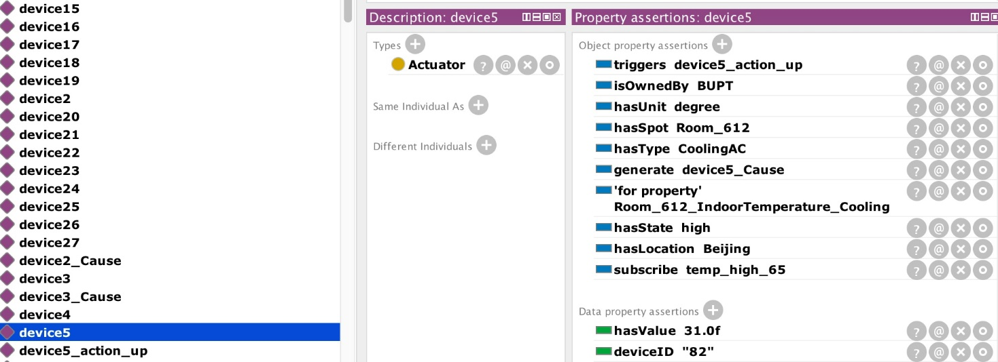
Usage of the knowledge graph
• Anomaly diagnosis
Automatic controlling
Semantic searching

Slide 17
THANK YOU!

